Slide 1
Top 5 Photographers Website
The main objective of the project is to inform our audience about the top 5 photographers. We designed the website with 13 webpages that will be compatible with mobile phones, PC and tablets.
Project Background:
The project proposed enables the users to view the top 5 photographers and also provide information about different types of photography. We also made a platform for amateur photographers to showcase their work.
Webpages:
The pages contained in our website are:
Home
Names - About & Gallery pages ( Joseph Radhik, Audi Photography, Photriya Photography, Avinash Gowariker, Amar Ramesh)
Creative ideas
Contact Us

Slide 2
Features
Colors: The colors used in website will be: White, Grey and black mostly.
Font Styles: Sans-Serif, Google Fonts(Lato & Montserrat)
Plugins : CSS, jQuery, HTML.
Features:
Our Webpages contains:
HTML5 semantic elements.
Compatible with Chrome ,Firefox and IE(Edge)
Images , Links , Dropdown, Paragraphs , Headings , Lists.
Search Functionality using AutoComplete widget which provides suggestions while you type into the field.
Block and Inline content
Header , Footer
Navigation menu & Flexible images
Forms with Data Validation

Slide 3
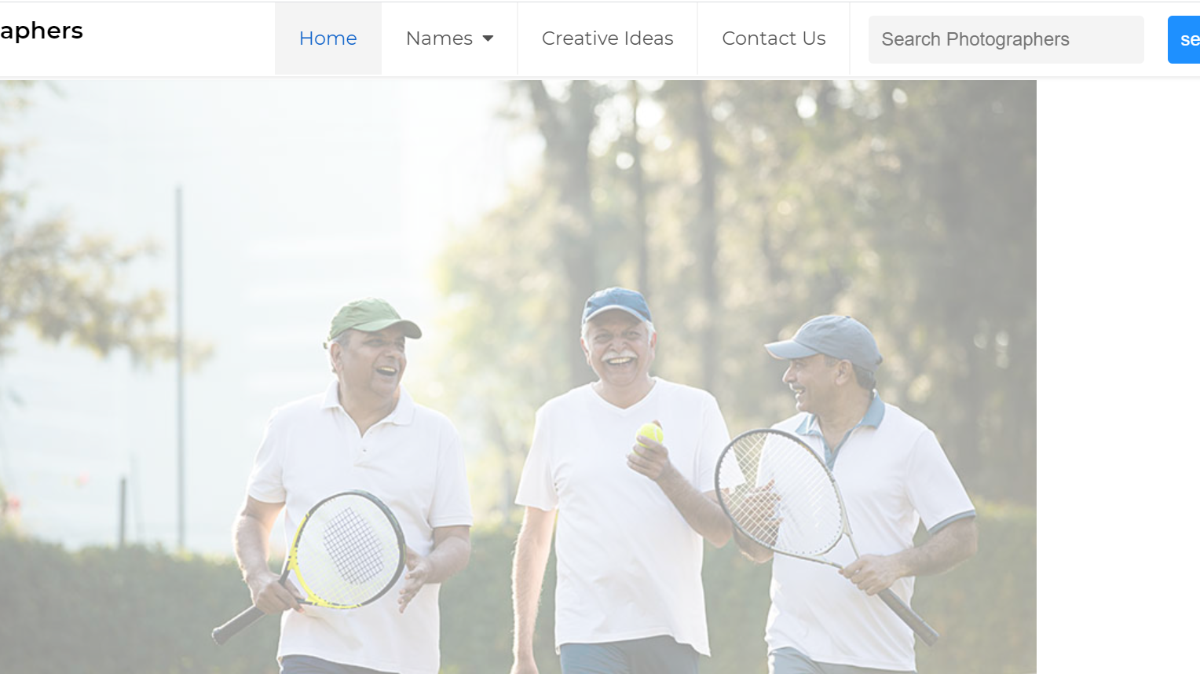
Home Page: In Home page , we can navigate to Names (5 photographers web pages) , Contact us , Creative ideas web pages and can also load the home page again.

Slide 4
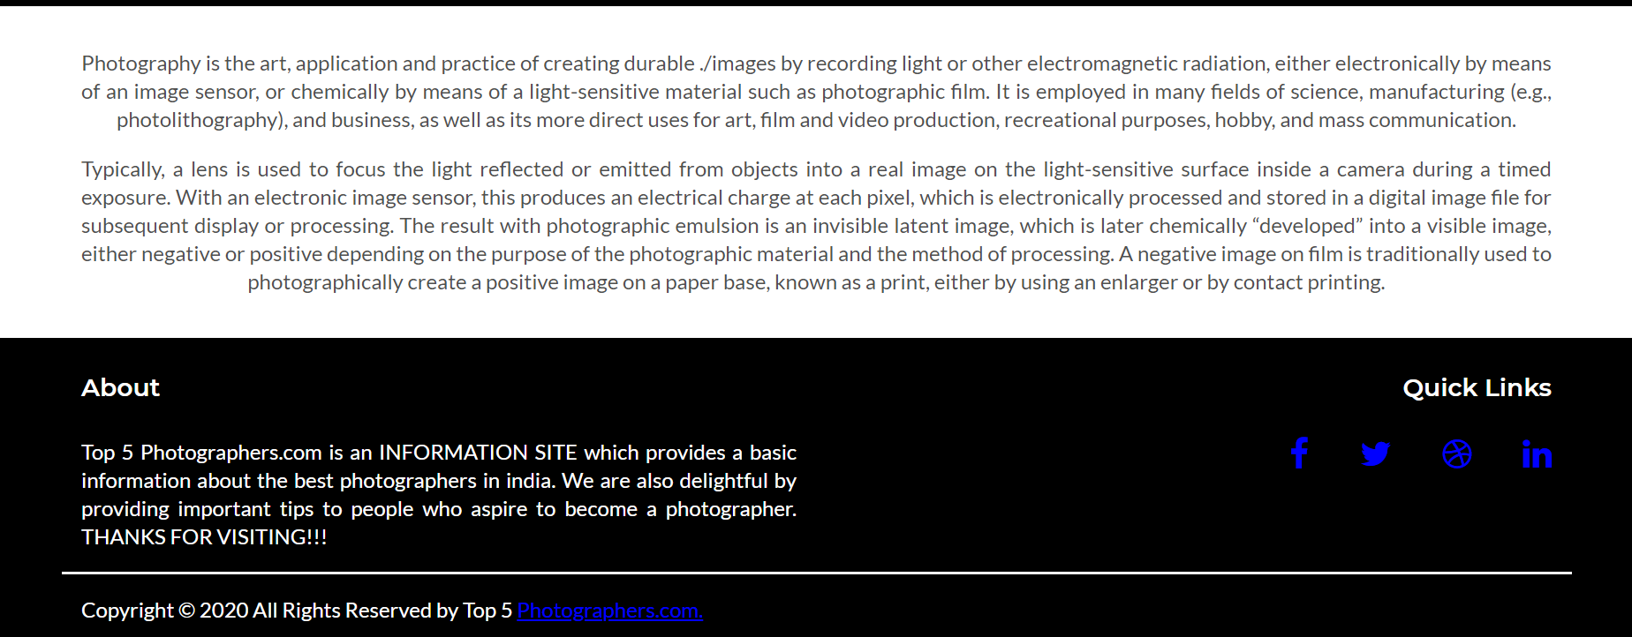
Home Page(continued): In the footer, there is About section which provides information and Quick links to Social media which are in inline.

Slide 5
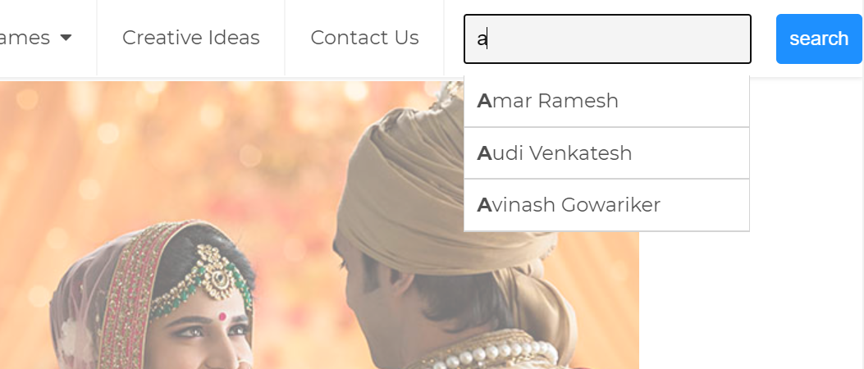
Home Page(continued): There is a search functionality for searching the name of the photographer which is implemented by using AutoComplete widget and also provides suggestions while you type into the field.

Slide 6
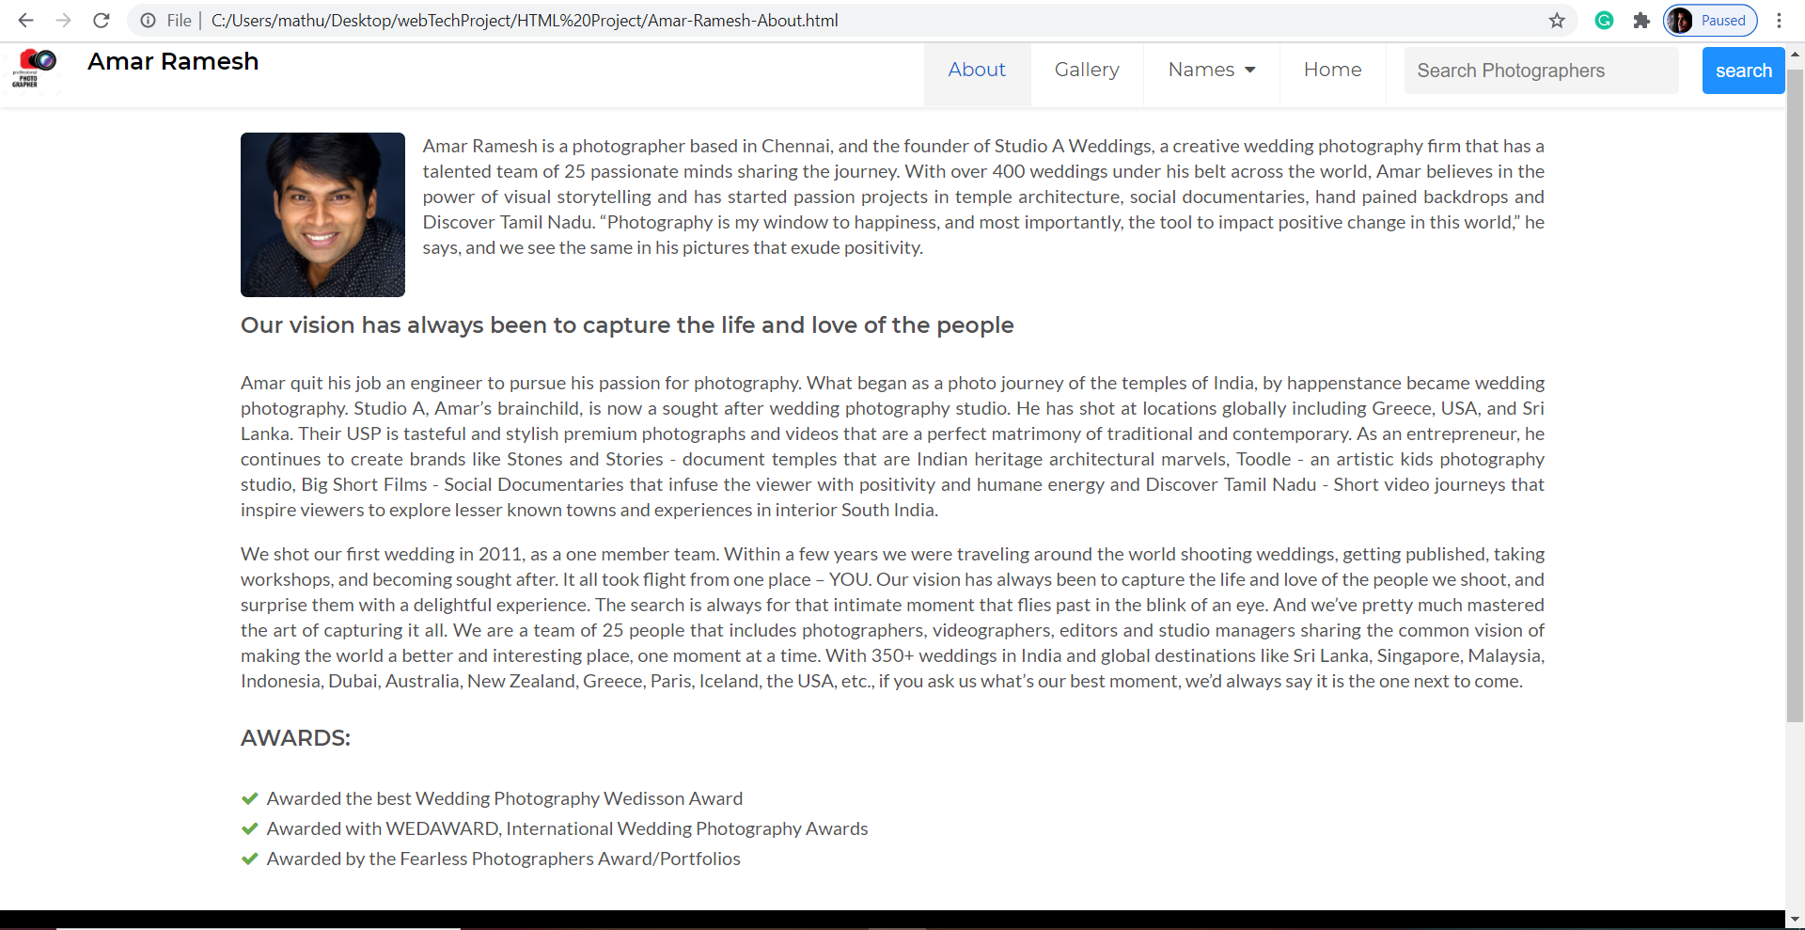
Names
Amar Ramesh webpage: In addition to Search functionality, Home webpage and Names , there are About and Gallery web pages.
About web page:

Slide 7
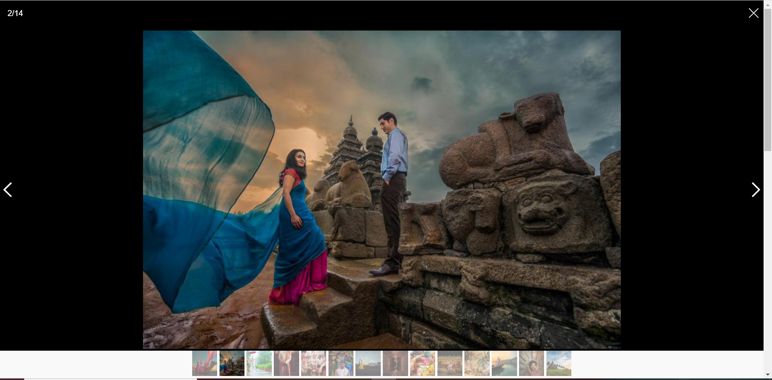
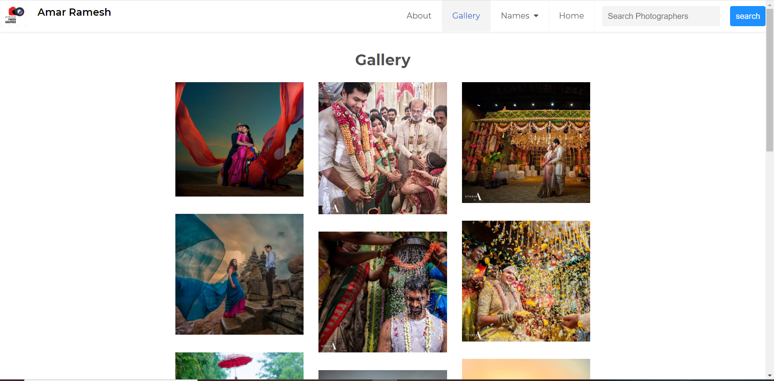
Gallery Web page(Amar Ramesh):
Smartphoto plugin is used for gallery webpage to slide between the images , draggable zoom feature and Amazing full screen mode.

Slide 8
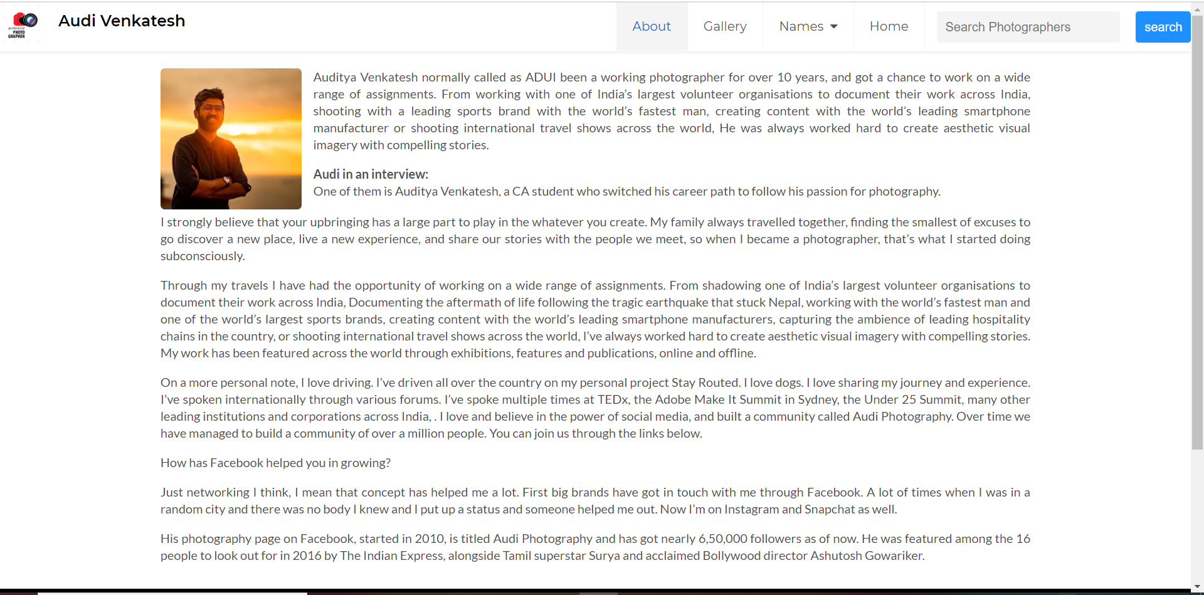
Names
Audi Venkatesh webpage: In addition to Search functionality, Home webpage and Names , there are About and Gallery web pages.
About web page:

Slide 9
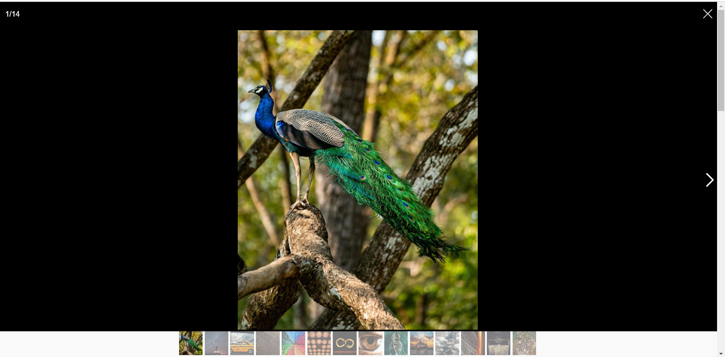
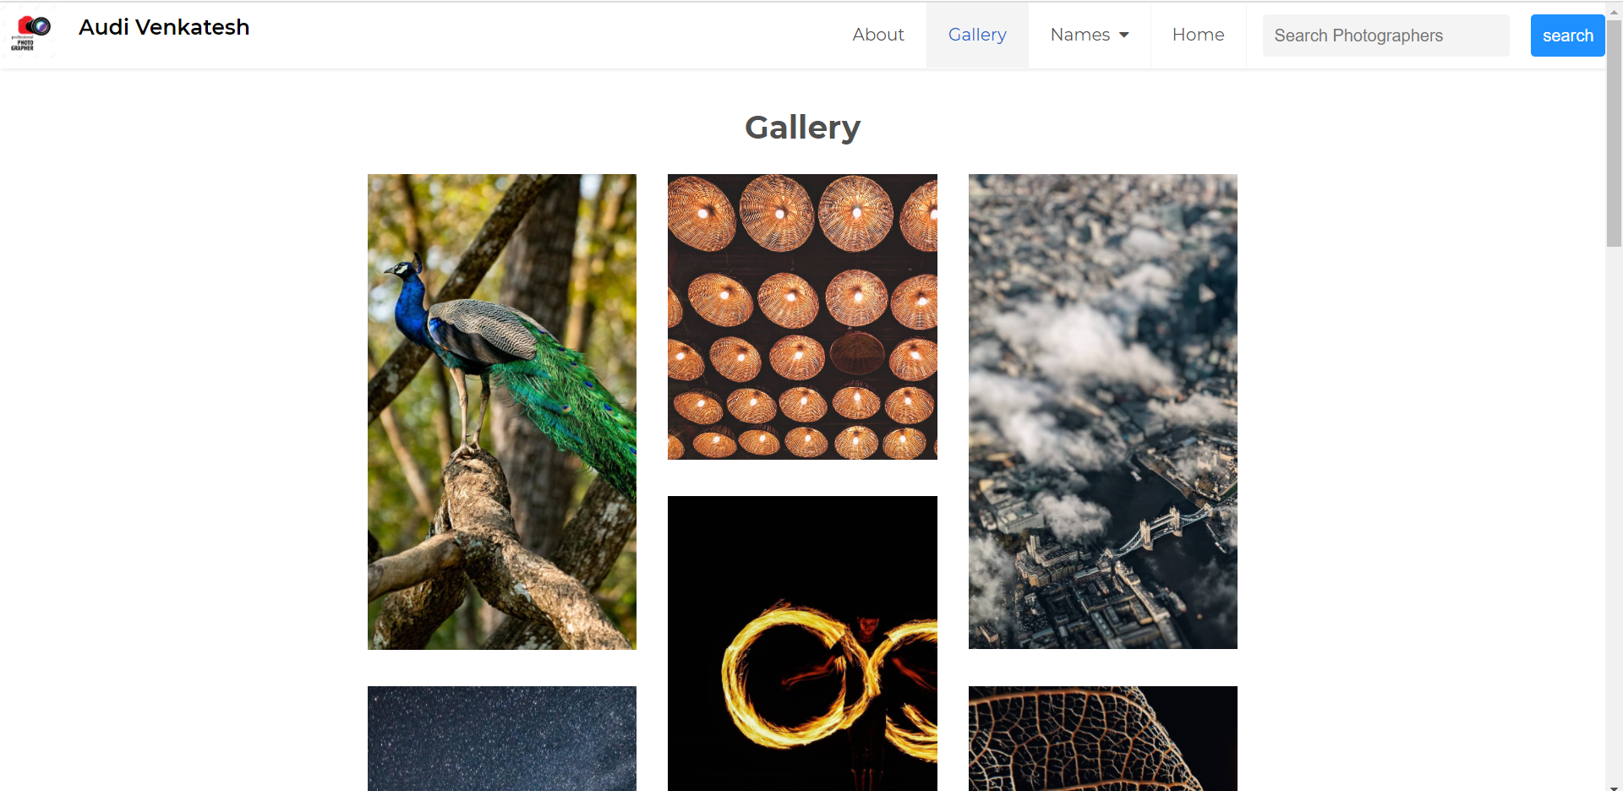
Gallery Web page(Audi Venkatesh):
Smartphoto plugin is used for gallery webpage to slide between the images , draggable zoom feature and Amazing full screen mode.

Slide 10
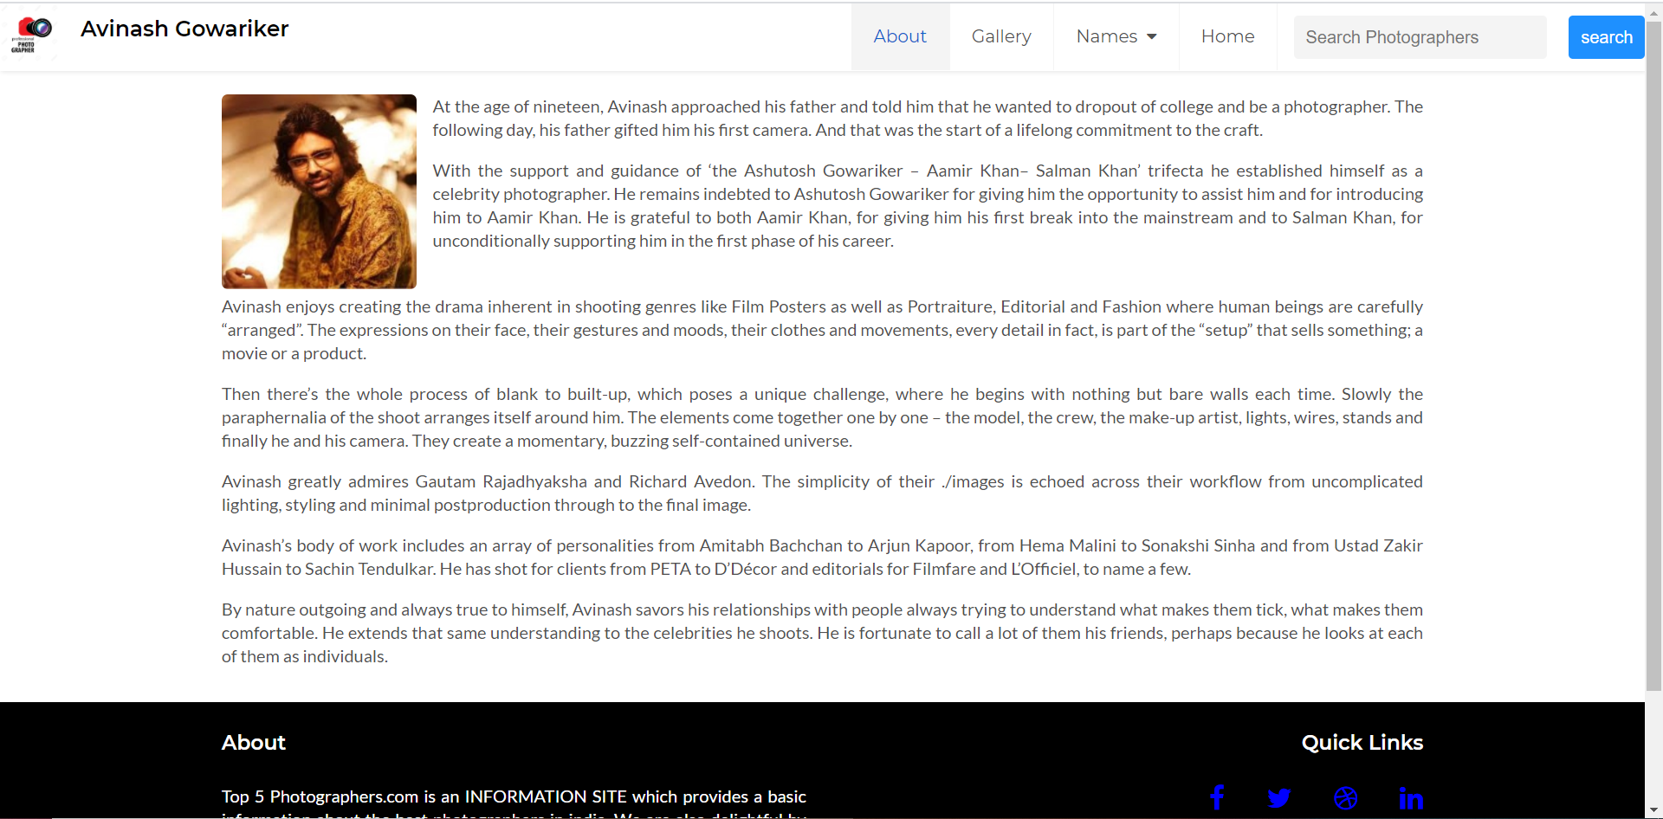
Names
Avinash Gowariker webpage: In addition to Search functionality, Home webpage and Names , there are About and Gallery web pages.
About web page:

Slide 11
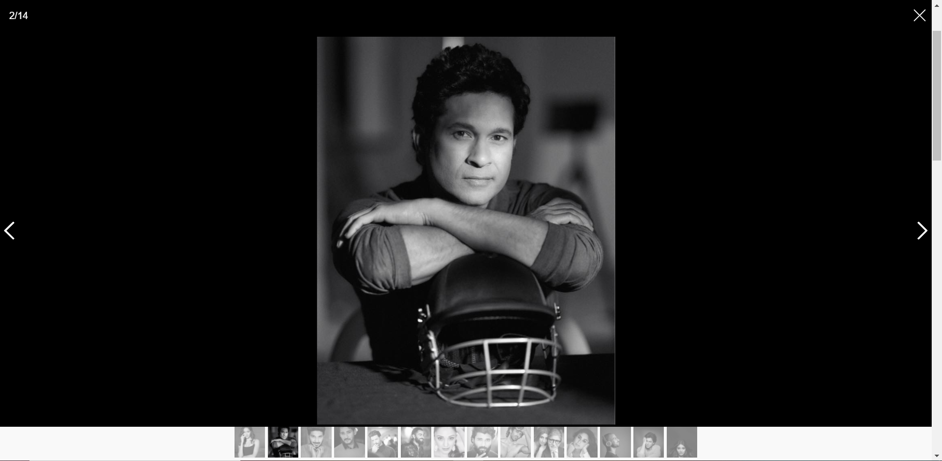
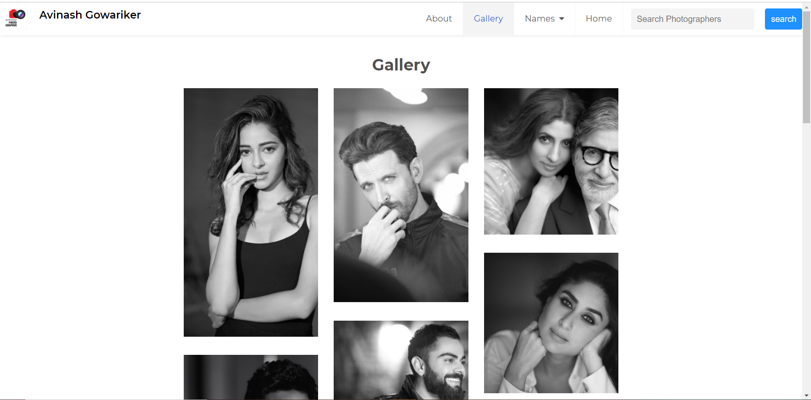
Gallery Web page(Avinash Gowariker):
Smartphoto plugin is used for gallery webpage to slide between the images , draggable zoom feature and Amazing full screen mode.

Slide 12
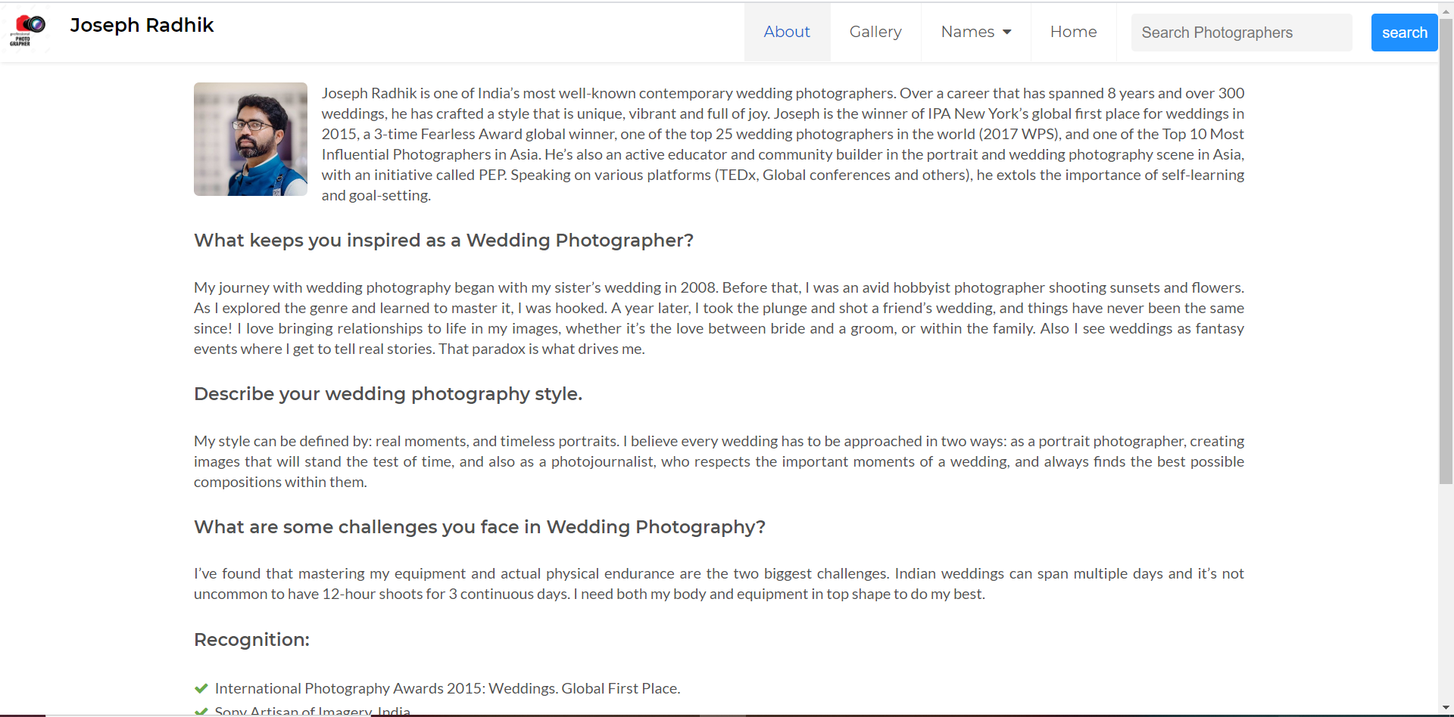
Names
Joseph Radhik webpage: In addition to Search functionality, Home webpage and Names , there are About and Gallery web pages.
About web page:

Slide 13
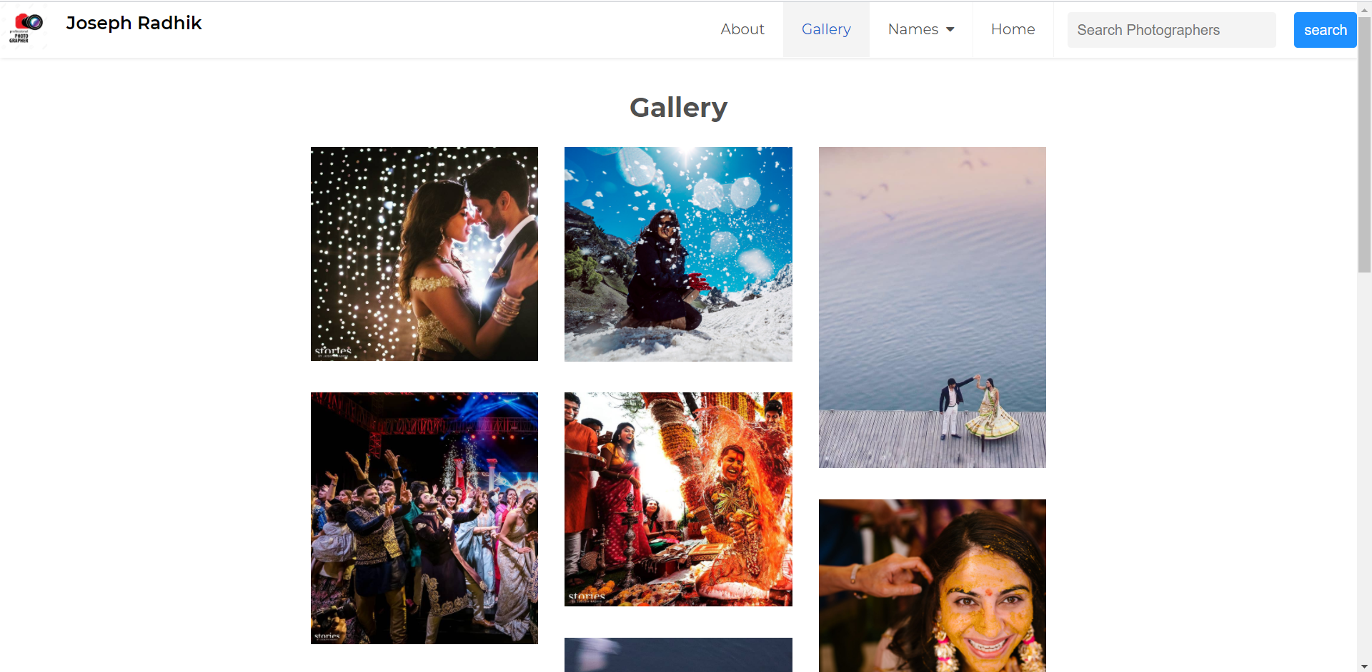
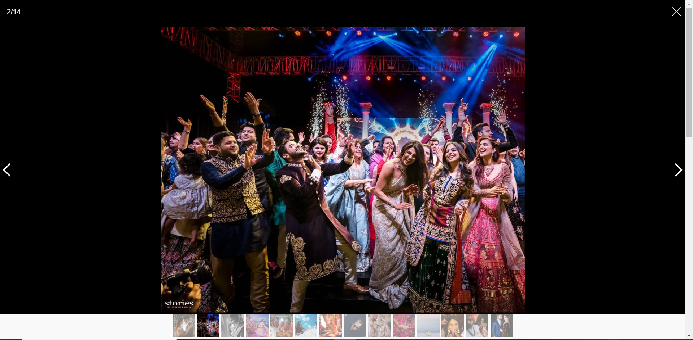
Gallery Web page(Joseph Radhik):
Smartphoto plugin is used for gallery webpage to slide between the images , draggable zoom feature and Amazing full screen mode.

Slide 14
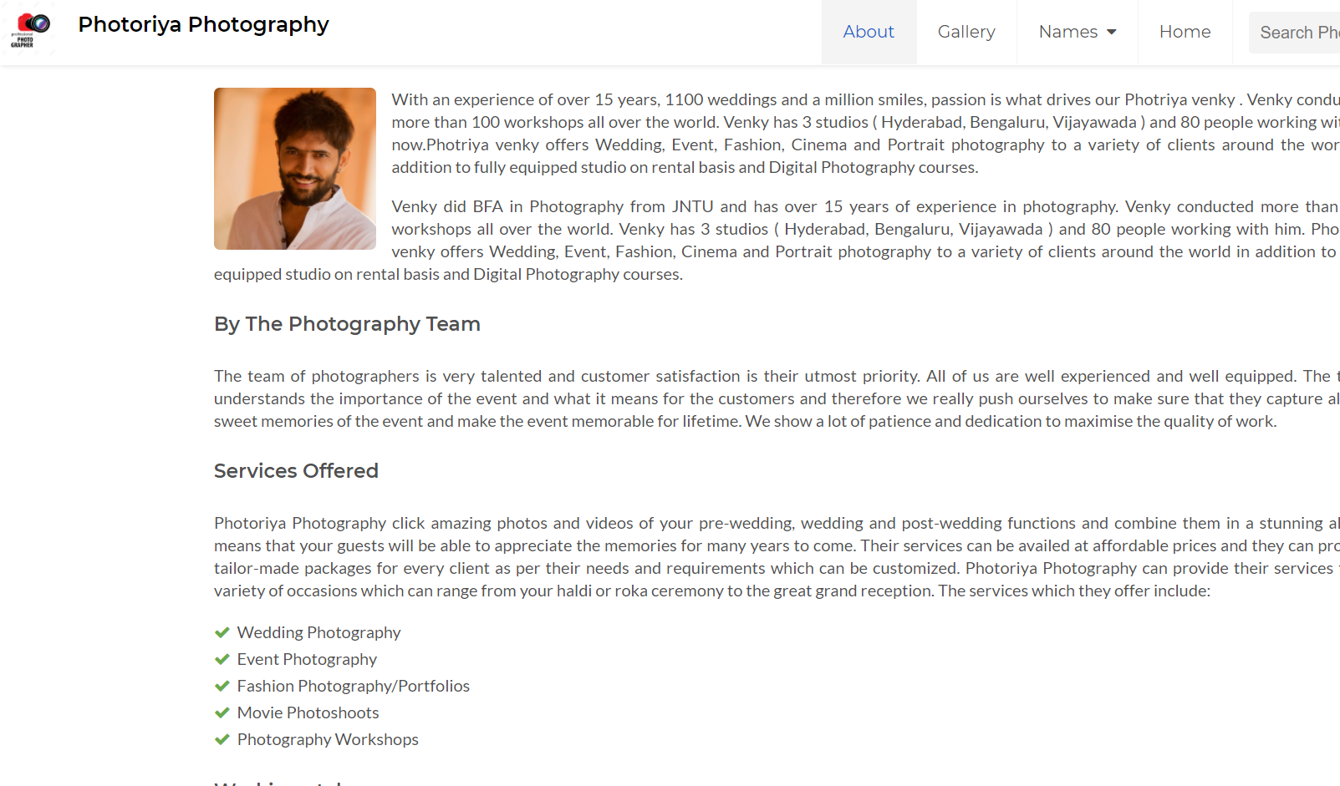
Names
Photriya webpage: In addition to Search functionality, Home webpage and Names , there are About and Gallery web pages.
About web page:

Slide 15
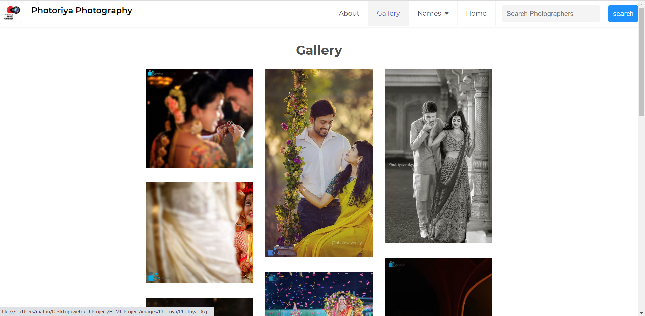
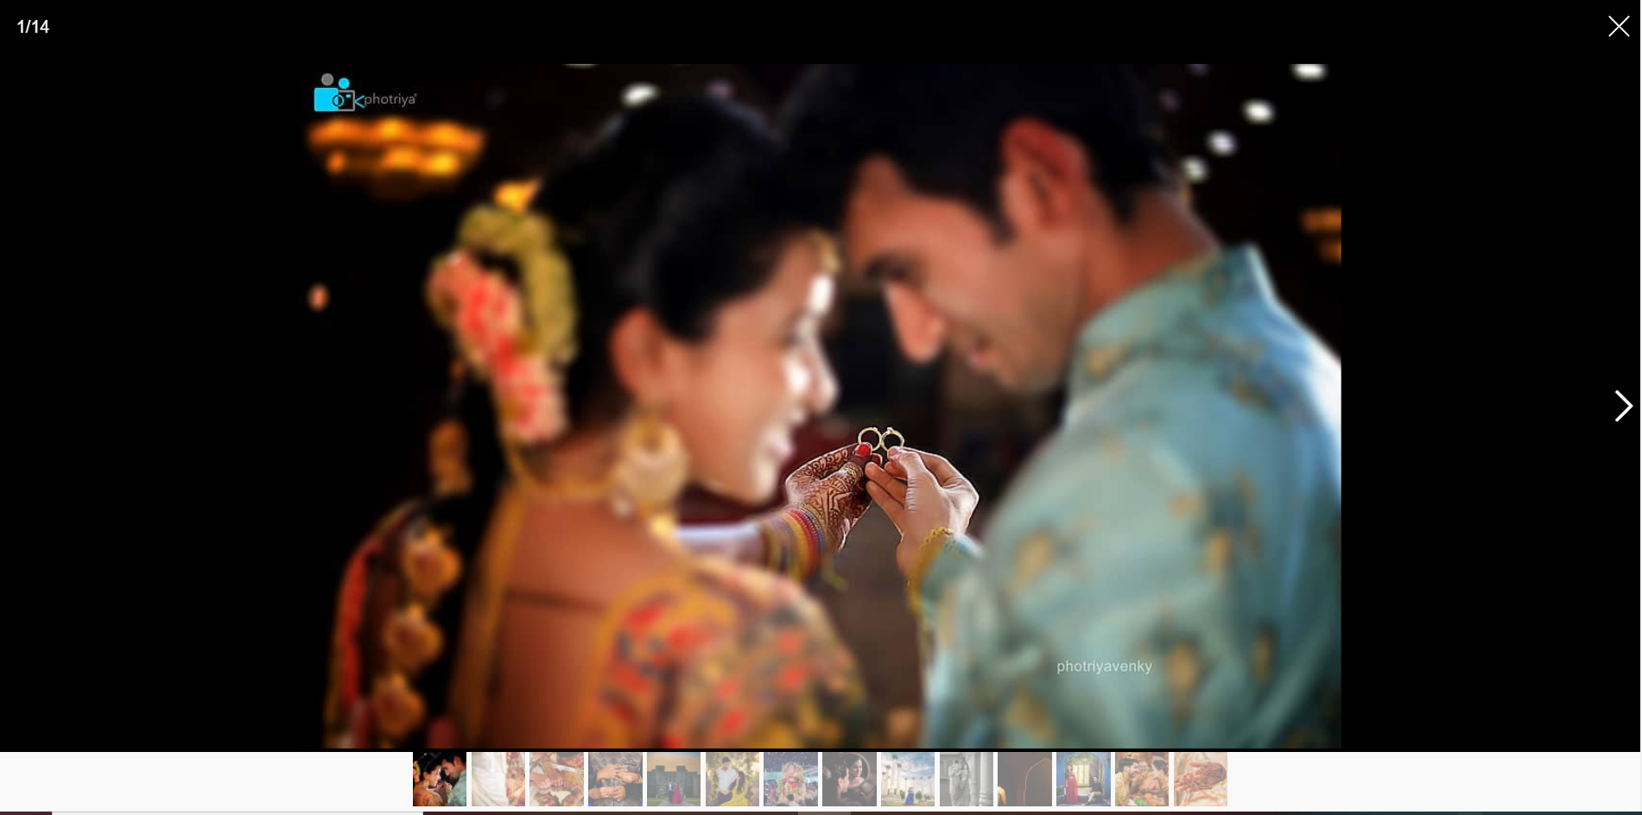
Gallery Web page(Photriya):
Smartphoto plugin is used for gallery webpage to slide between the images , draggable zoom feature and Amazing full screen mode.

Slide 16
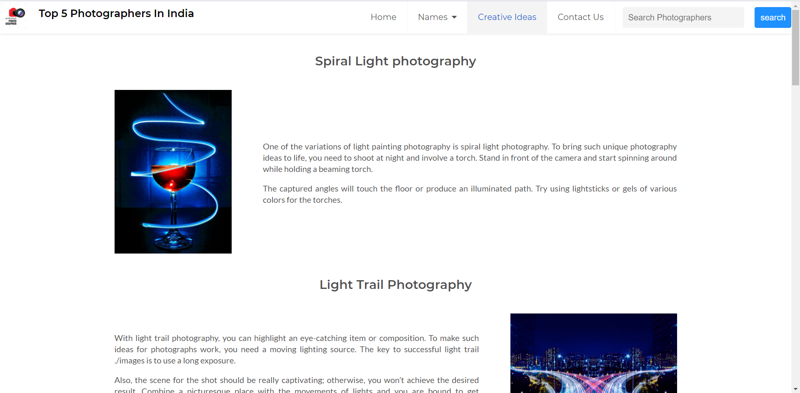
Creative Ideas web page: This web page will provide information about different types of photography.
we also used animations like toggleslide, fading effects in this page.

Slide 17
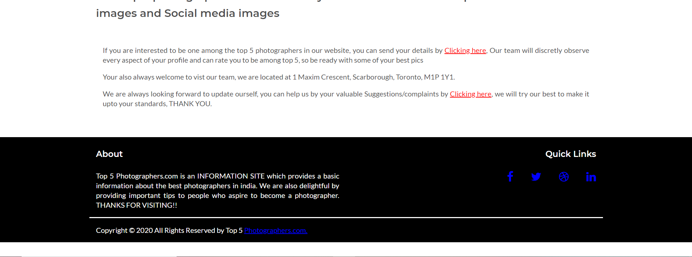
Contact us web page: This webpage allows to reach the organization and also provide suggestion/feedback by filling the form.

Slide 18
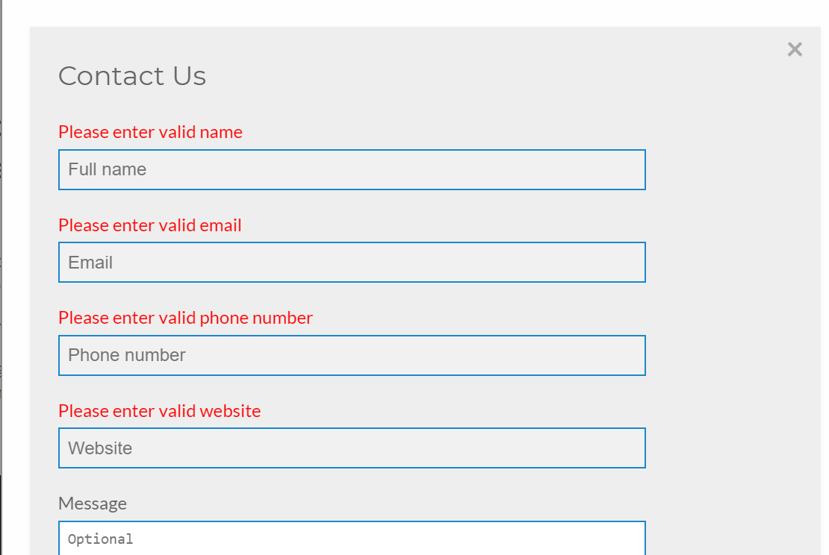
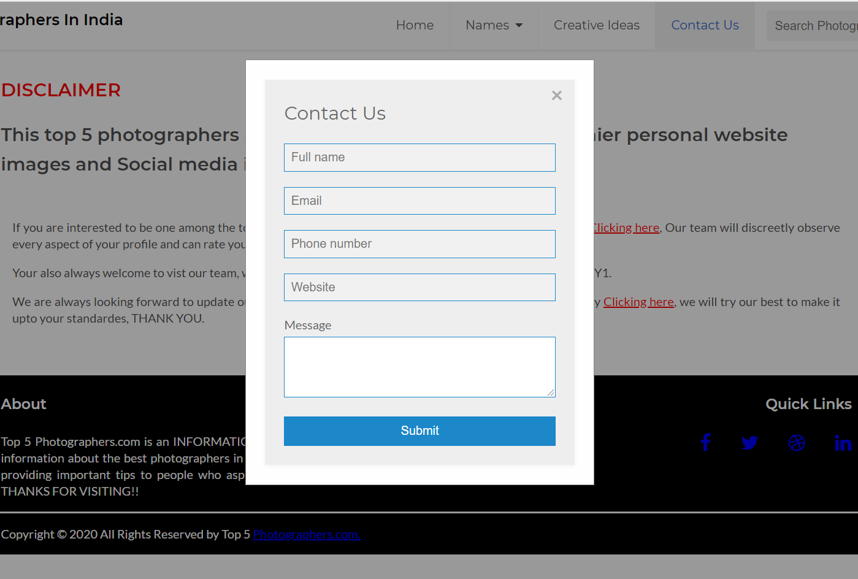
Contact us web page(continued): This webpage has two forms with data validation , one is to be one of the top photographer and other is for providing feedback/suggestions.

Slide 19
REFERENCES
Autocomplete search field
https://www.w3schools.com/howto/tryit.asp?filename=tryhow_js_autocomplete
2. Responsive Mobile-first Image Viewer - jQuery SmartPhoto
https://www.jqueryscript.net/demo/Responsive-Mobile-first-Image-Viewer-jQuery-SmartPhoto/

Slide 20
THANK YOU

